Slide 1
MediFlow Lakehouse
Hospital Operations & Patient Journey Data Platform on Azure Databricks
Medallion Architecture | Unity Catalog Governance | AI/BI Reporting | Predictive ML
LAKEHOUSE FOUNDATIONS
ORCHESTRATION & ANALYTICS
Dheeraj — Overview & Bronze Ingestion
Clinical operational challenge & goals
Hybrid ingestion: Azure SQL & ADLS
Auto Loader with rescued data safety
Nitesh — Pipelines & Orchestration
Databricks Lakeflow 7-task DAG
Dependency orchestration & reruns
Zero-drift idempotency guarantees
Sanjay — Silver Layer & Quality Quarantine
DQ001–DQ008 automated validation rules
Quarantine table isolation for errors
Mathematical row audit reconciliation
Abu — AI/BI Operational Dashboard
2-page production operational dashboard
Patient flow & 15m median lab TAT cards
Department rankings & bed capacity mix
Arnav — Gold Layer & Dimensional Modeling
Kimball Star Schema (4 dims, 3 facts)
SHA-256 patient pseudonymization
Incremental daily KPI aggregation mart
Harsha — MLflow & Predictive Analytics
Admission-time long-stay risk pilot
MLflow tracking & @champion UC registry
Databricks Genie conversational NLP

Slide 2
Problem Statement
THE CORE OPERATIONAL CHALLENGE
Hospital systems record patient arrivals, lab tests, and bed transfers in disconnected silos. Without an integrated lakehouse, clinical leadership cannot accurately track patient journey bottlenecks, wait times, or real-time bed capacity.
THREAT 1 Data Quality Threats (Operational Risks)
Batch Re-transmission Duplication: Overlapping source batches (47 duplicate encounters) inflate admissions and bed demand.
Unmapped Clinical Codes: 24 records with triage_priority = 'UNKNOWN_CODE' crash downstream reporting and triage workflows.
Chronological Inversions: Clock errors create impossible timelines (discharge before admission, results before orders).
THREAT 2 Governance & Regulatory Exposure (Compliance Risks)
HIPAA & Data Privacy Vulnerability: Raw identifiers (patient_id, patient codes) in operational reporting violate privacy standards.
Audit Trail Breakdown: Batch scripts drop bad records silently, erasing what the source originally transmitted.
Metric Drift: Departments query different snapshots, producing conflicting numbers in executive meetings.
THE ENGINEERING MANDATE Deliver an automated, idempotent Lakehouse with Zero Silent Loss:
Raw Bronze Data = Clean Silver + Quarantine + Audited Duplicates
Guaranteed by cryptographic privacy, mathematical row reconciliation, and sub-second serverless BI.

Slide 3
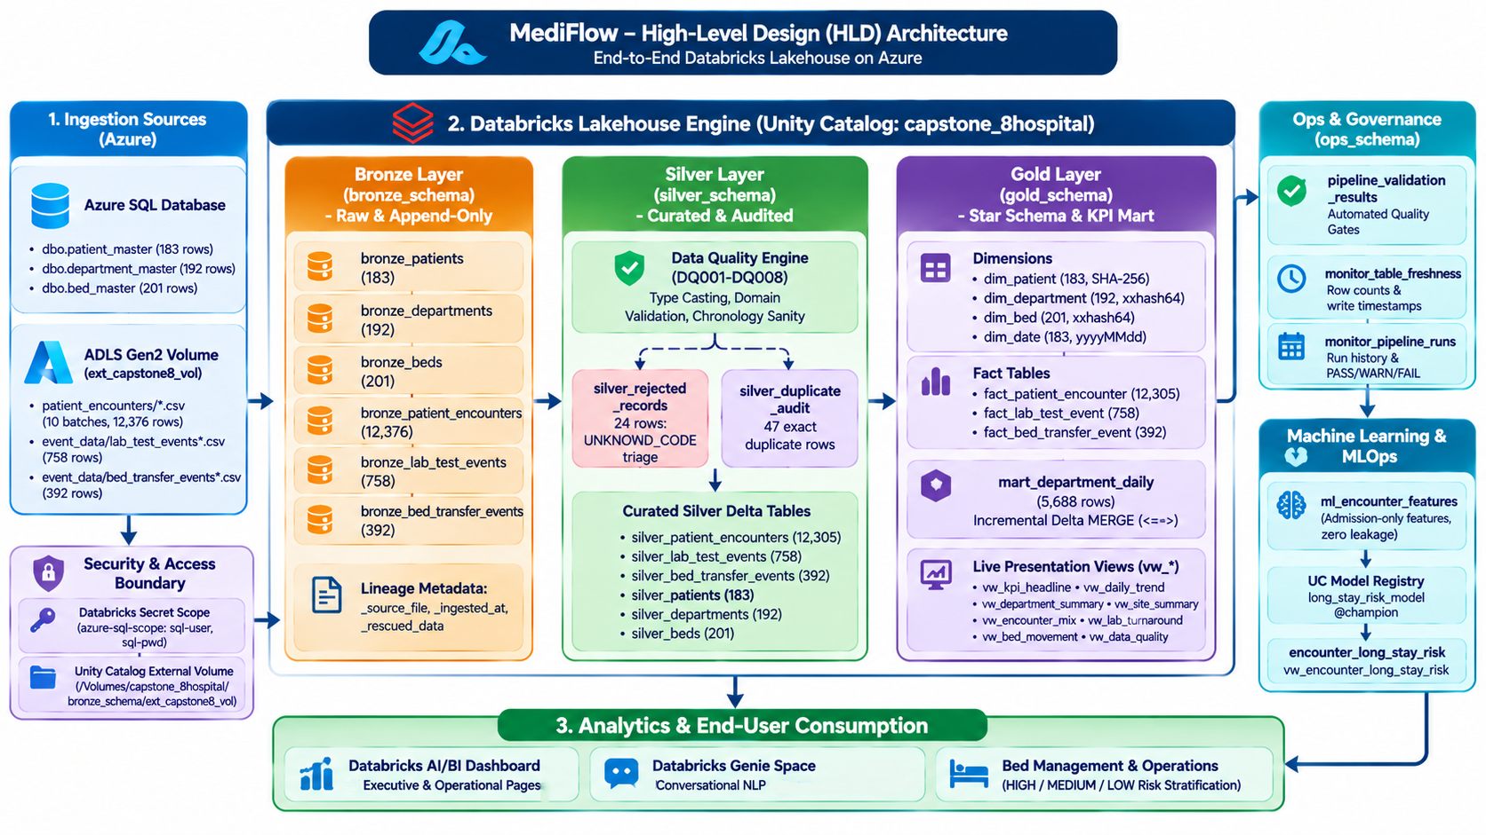
System Architecture – HLD System Architecture

Slide 4
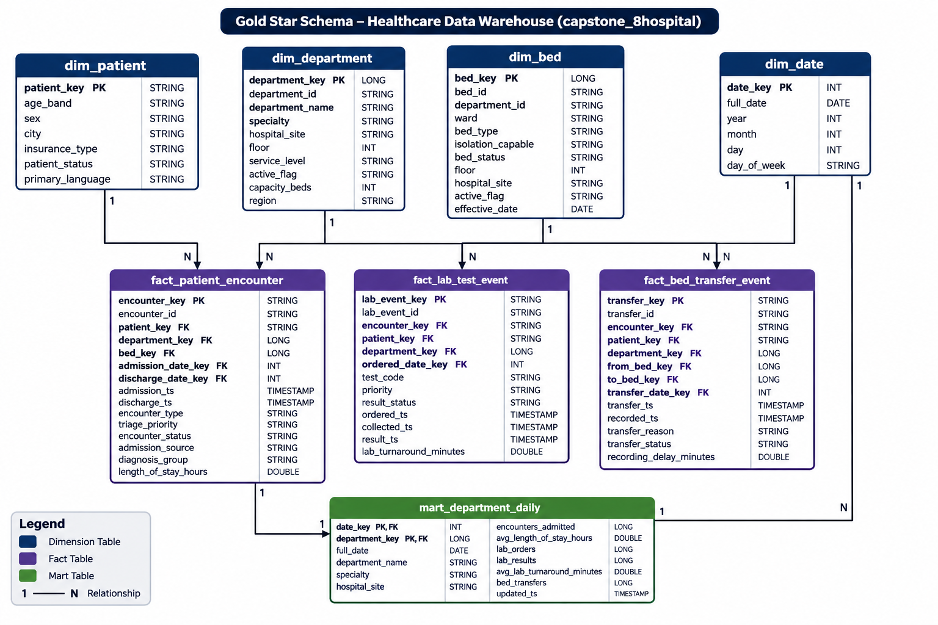
System Architecture – LLD Components

Slide 5
Medallion Architecture
BRONZE Raw & Traceable
SILVER Curated & Quarantined
GOLD Star Schema & KPI Mart
Design Mandate: Verbatim fidelity—raw data captured exactly as transmitted, without alteration
Storage Engine: Append-only Delta Lake tables with full ACID transaction logs and time travel
Dual Ingestion Paths
Azure SQL (JDBC): master tables (bronze_patients, departments, beds)
ADLS Gen2 (Auto Loader): event streams (bronze_patient_encounters, lab_test_events, bed_transfer_events)
Lineage & Audit Enrichment
_source_file (storage URI) and _ingested_at (UTC) on every record
Unparseable or drifted data preserved in _rescued_data
Total Raw Volume: 14,102 rows across 6 Delta tables in capstone_8hospital.bronze_schema
Design Mandate: Single version of truth—strict clinical types, standardized text, no duplicates
8-Rule Quality Engine (DQ001–DQ008)
Strict casting to ISO timestamps, integer capacities and dates
Clinical domain categories and temporal sanity (discharge ≥ admission)
“Zero Silent Loss” Quarantine
silver_rejected_records (24 rows): unmapped triage codes (UNKNOWN_CODE) isolated with full raw JSON
silver_duplicate_audit (47 rows): redundant batch records pruned via business-column comparison
Exact Reconciliation: Bronze (12,376) = Silver (12,305) + Rejected (24) + Duplicates (47)
Design Mandate: High-performance BI & ML delivery in a Kimball-style Star Schema
Privacy-by-Design: Zero raw PII in Gold—patient_id replaced by SHA-256(patient_id) hash (patient_key)
Deterministic Surrogate Keys: Stateless xxhash64 and sha2—reproducible across cluster rebuilds
Star Schema Layout
4 Dimensions: dim_patient (183), dim_department (192), dim_bed (201), dim_date (183)
3 Facts: Encounters (12,305), Labs (758), Bed Transfers (392)
Incremental KPI Mart (mart_department_daily)
5,688 daily rows via Delta MERGE INTO with null-safe <=>
Idempotent: replays yield zero duplicates and zero drift
Zero Silent Loss
Failed records quarantined with JSON; nothing is dropped
Cryptographic Privacy
Raw patient IDs never enter Gold (patient_key = SHA-256)
Delta Lake MERGE
Idempotent daily mart upsert with null-safe <=>
Mathematical Balance
12,376 Bronze = 12,305 Silver + 24 Rej + 47 Dup

Slide 6
Workflow & Pipeline Orchestration
Enterprise Orchestration & SLA Performance
7-Stage Automated DAG Execution Flow
Fault Tolerance & Circuit-Breaker Governance
Orchestration Engine: Databricks Lakeflow Jobs (Pipeline Job: cap8_PIPE, ID: 784129931086509)
Trigger Architecture: File-arrival triggers on Unity Catalog Volumes plus scheduled daily batch runs
SLA Performance: Target under 15 min | Actual 7 min 55 sec (~48% buffer)
Data Freshness: Enforces <24h operational data availability for hospital leadership
Dynamic Parameterization: Parameterized across environments using {{job.run_id}}, catalog and schema namespaces
1a/b
Parallel Ingestion Tier
bronze_adls_autoloader (57s) & bronze_azure_sql (47s) run concurrently
Automated Circuit Breaker: If a reconciliation check fails (Bronze ≠ Silver + Rejected + Duplicates), the pipeline halts immediately
Zero Bad Data Downstream: Unvalidated metrics never reach executive dashboards
Task Retries & Resilience: 2 automatic retries at 1-min intervals for transient network/database pauses
Partial DAG Repair: Databricks “Repair Run” reruns only the failed task and downstream dependencies—no costly upstream re-computation
Operational Telemetry: Every run writes status, run times and check results to ops_schema.pipeline_validation_results
2
Automated Profiling Gate
data_profile (31s): validates volume, schema completeness, null distributions
3
Curated Quality Processing
silver_transform (2m 26s): rules DQ001–DQ008, quarantine isolation, deduplication
4
Dimensional Modeling & Mart Build
gold_build (1m 25s): star schema dims & facts, incremental Delta MERGE
5
End-to-End Quality Gate
validation (1m 29s): 30+ cross-layer assertions; aborts pipeline on any failure
6
Telemetry & Dashboard Refresh
refresh_dashboard (1m 03s): freshness telemetry to ops_schema, refreshes AI/BI views
7m 55s
Total Job Duration (SLA: 15m)
0s
Total Job Duration (SLA: 15m)
2m 21s
Total Job Duration (SLA: 15m)
4m 12s
Total Job Duration (SLA: 15m)
5m 34s
Total Job Duration (SLA: 15m)
6m 34s
Total Job Duration (SLA: 15m)
7m 13s
Total Job Duration (SLA: 15m)
7m 37s
Total Job Duration (SLA: 15m)
7m 50s
Total Job Duration (SLA: 15m)
7m 54s
Total Job Duration (SLA: 15m)
7m 55s
Total Job Duration (SLA: 15m)
478
Queries Executed
0
Queries Executed
142
Queries Executed
253
Queries Executed
336
Queries Executed
396
Queries Executed
436
Queries Executed
460
Queries Executed
473
Queries Executed
477
Queries Executed
478
Queries Executed
765,242
Raw Rows Read
24 → 23
End-to-End Lineage: Upstream → Downstream Tables
0
Raw Rows Read
227,788
Raw Rows Read
405,190
Raw Rows Read
538,504
Raw Rows Read
634,028
Raw Rows Read
698,060
Raw Rows Read
736,900
Raw Rows Read
756,844
Raw Rows Read
764,192
Raw Rows Read
765,242
Raw Rows Read

Slide 7
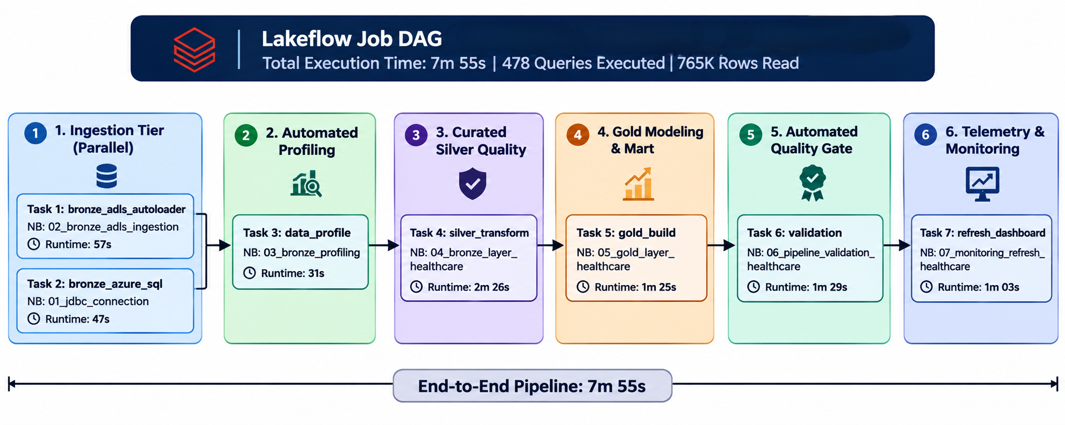
Workflow & Pipeline Orchestration Diagram

Slide 8
Dataset Specifications & Profiling
DATA FOUNDATION
Ingested Dataset Inventory
2×2 Automated Profiling Matrix (03_bronze_profiling)
RELATIONAL MASTERS (AZURE SQL)
patient_master (183 rows, 10 cols): demographics, 6 language groups, 3 insurance classes
department_master (192 rows, 10 cols): 6 regional medical sites, 899 planned capacity beds
bed_master (201 rows, 10 cols): physical bed inventory, ward types, 51.7% isolation-capable
CLINICAL EVENT FEEDS (ADLS GEN2)
patient_encounters (12,376 rows, 15 cols): Jul 1 – Aug 30, 2026, across 10 batch CSV files
lab_test_events (758 rows, 13 cols): CBC, GLUCOSE, KFT, LFT
bed_transfer_events (392 rows, 13 cols): CAPACITY, CLINICAL, ISOLATION
Q1 · DUPLICATION PROFILE
47 duplicate rows
Evaluated 12,376 encounter records vs 12,329 distinct encounter_id values
Finding: 47 exact duplicates from overlapping CSV batch transmissions
Action: deterministic business-column deduplication in Silver
Q2 · CATEGORICAL DOMAIN PROFILE
24 UNKNOWN_CODE rows
Verified triage, encounter type, test code and transfer reason distributions
Finding: 24 encounters with invalid triage priority UNKNOWN_CODE (valid: P1–P4)
Action: routed to silver_rejected_records under rule DQ003
Q3 · NULLITY & RELATIONAL INTEGRITY
100% master keys populated
discharge_ts NULL only for currently admitted patients (clinically valid)
diagnosis_group has 6 NULLs
Reference master keys fully populated—zero missing values
Q4 · TEMPORAL & DURATION BASELINE
≈4.8 min avg length of stay (≈0.08 h)
Lab turnaround (TAT) ≈15 mins; bed transfer delay ≈5 mins
Finding: uniform durations stem from synthetic source generation—pipeline calculations are 100% mathematically accurate
14,102 raw records
across 6 operational entities
0 raw records
across 6 operational entities
4,198 raw records
across 6 operational entities
7,467 raw records
across 6 operational entities
9,924 raw records
across 6 operational entities
11,684 raw records
across 6 operational entities
12,864 raw records
across 6 operational entities
13,580 raw records
across 6 operational entities
13,947 raw records
across 6 operational entities
14,083 raw records
across 6 operational entities
14,102 raw records
across 6 operational entities

Slide 9
Data Ingestion from Landing Zone
Dual-Source Ingestion Architecture: Relational Reference Masters & Real-Time Event Streams
Relational Master Engine Azure SQL via PySpark JDBC
Event Streaming Engine ADLS Gen2 via Databricks Auto Loader
Direct JDBC to Azure SQL: capstone8dbserver.database.windows.net:1433
TLS 1.2 encrypted pipeline (encrypt=true)
Zero hardcoded credentials: runtime auth via Databricks Secret Scope azure-sql-scope
Hospital master entities ingested:
patient_master (183 rows)
department_master (192 rows)
bed_master (201 rows)
Memory-efficient batch reads
Storage: ADLS Gen2 landing container via Unity Catalog External Volume (ext_capstone8_vol)
Format: .format("cloudFiles") over CSV event batches
Exactly-once processing: persistent RocksDB-backed checkpoint state
Auto schema evolution (adds NewColumns)
Corrupt record rescue into _rescued_data
Trigger: .trigger(availableNow=True) — high-throughput burst with immediate cluster shutdown
ZERO-LEAKAGE SECURITY & PRE-FLIGHT INTEGRITY SHIELD
Databricks Secret Scope: credentials retrieved at runtime via dbutils.secrets.get("azure-sql-scope") — never hardcoded
Pre-Flight Guard: aborts ingestion if a target table has rows but its checkpoint is missing — prevents accidental duplicate loads

Slide 10
Bronze Layer — Raw & Traceable
Verbatim Fidelity, Immutable Audit Lineage & Automated Pre-Processing Profiling
14,102
Total Bronze Rows
0
Total Bronze Rows
4,198
Total Bronze Rows
7,467
Total Bronze Rows
9,924
Total Bronze Rows
11,684
Total Bronze Rows
12,864
Total Bronze Rows
13,580
Total Bronze Rows
13,947
Total Bronze Rows
14,083
Total Bronze Rows
14,102
Total Bronze Rows
6
Delta Tables
0
Delta Tables
2
Delta Tables
3
Delta Tables
4
Delta Tables
5
Delta Tables
5
Delta Tables
6
Delta Tables
6
Delta Tables
6
Delta Tables
6
Delta Tables
100%
Raw Fidelity — no filtering, casting or dedup
0%
Raw Fidelity — no filtering, casting or dedup
30%
Raw Fidelity — no filtering, casting or dedup
53%
Raw Fidelity — no filtering, casting or dedup
70%
Raw Fidelity — no filtering, casting or dedup
83%
Raw Fidelity — no filtering, casting or dedup
91%
Raw Fidelity — no filtering, casting or dedup
96%
Raw Fidelity — no filtering, casting or dedup
99%
Raw Fidelity — no filtering, casting or dedup
100%
Raw Fidelity — no filtering, casting or dedup
100%
Raw Fidelity — no filtering, casting or dedup
Append-Only
Delta ACID ledger with time travel
Ingested Bronze Fleet bronze_schema
Audit Lineage & Profiling Discoveries 03_bronze_profiling.py
REFERENCE MASTERS (AZURE SQL)
bronze_patients: 183 rows
bronze_departments: 192 rows
bronze_beds: 201 rows
CLINICAL EVENTS (ADLS GEN2)
bronze_patient_encounters: 12,376 rows
bronze_lab_test_events: 758 rows
bronze_bed_transfer_events: 392 rows
IMMUTABLE LINEAGE METADATA — STAMPED ON EVERY RECORD
_source_file: full ADLS storage URI tracking origin
_ingested_at: UTC microsecond arrival timestamp
_rescued_data: captures unparseable fields or schema drift without dropping rows
AUTOMATED PROFILING ENGINE
116 summary metrics logged in bronze_schema.profiling_summary
47 duplicate encounters detected across batch boundaries
24 encounters with unmapped triage priority (UNKNOWN_CODE)
Reference masters verified 100% clean
Mandate: absolutely zero business filtering, casting, or deduplication
Mandate: surface all anomalies early; preserve raw payloads for auditable quarantine in Silver

Slide 11
Silver Layer — Curated, Quarantined & Reconciled
The 8-Rule Data Quality Framework, Automated Quarantine & Zero Silent Data Loss
THE MATHEMATICAL ROW RECONCILIATION GUARANTEE
Bronze Encounters (12,376) = Clean Silver (12,305) + Quarantined (24) + Duplicate Audit (47)
Audit Balance: 100.00% Verified | Silent Drops: 0 Rows | Data Loss: Exactly 0.00%
8-Rule Data Quality Engine DQ001 – DQ008 Framework
Zero-Loss Quarantine Engine Automated Isolation & Clean Outputs
DQ001 (Critical): mandatory key completeness (encounter_id, patient_id, admission_ts)
DQ002 (High): strict typing — strings cast to ISO timestamps & numeric types
DQ003 (High): domain validation — triage priority ∈ {P1, P2, P3, P4}
DQ004 (High): physical boundaries — capacity beds ≥ 1, floor ≥ 0
DQ005 (High): chronology — discharge_ts ≥ admission_ts, result_ts ≥ ordered_ts
DQ006 (High): business-key dedup — latest record kept via window ranking
DQ007 & DQ008 (Review): referential integrity & orphan event preservation (WARN, never dropped)
silver_rejected_records (24): quarantined under DQ003_INVALID_PRIORITY with full raw JSON (_raw_record), source file & failure timestamp
silver_duplicate_audit (47): batch re-transmission duplicates isolated via window ranking for data steward review
CLEAN CURATED SILVER OUTPUT FLEET
12,305
Encounters
0
Encounters
3,663
Encounters
6,515
Encounters
8,659
Encounters
10,195
Encounters
11,225
Encounters
11,849
Encounters
12,170
Encounters
12,288
Encounters
12,305
Encounters
758
Labs
0
Labs
226
Labs
401
Labs
533
Labs
628
Labs
691
Labs
730
Labs
750
Labs
757
Labs
758
Labs
392
Transfers
0
Transfers
117
Transfers
208
Transfers
276
Transfers
325
Transfers
358
Transfers
377
Transfers
388
Transfers
391
Transfers
392
Transfers
183
Patients
0
Patients
54
Patients
97
Patients
129
Patients
152
Patients
167
Patients
176
Patients
181
Patients
183
Patients
183
Patients
192
Depts
0
Depts
57
Depts
102
Depts
135
Depts
159
Depts
175
Depts
185
Depts
190
Depts
192
Depts
192
Depts
201
Beds
0
Beds
60
Beds
106
Beds
141
Beds
167
Beds
183
Beds
194
Beds
199
Beds
201
Beds
201
Beds

Slide 12
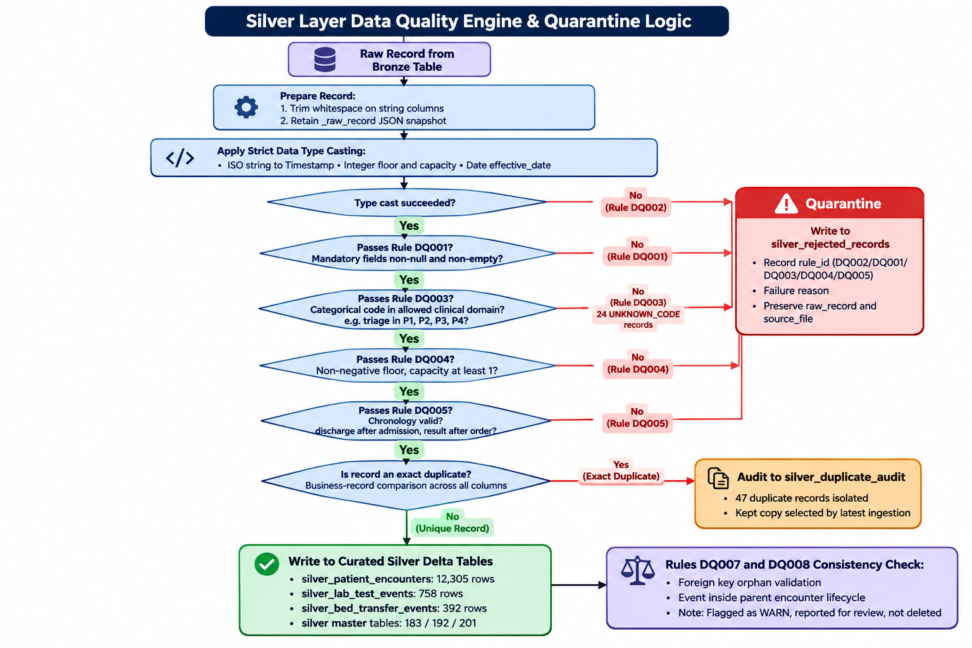
Silver Layer Logic Diagram

Slide 13
Gold Layer — Star Schema & Incremental Mart
Kimball Dimensional Modeling, Cryptographic PHI Shield & Idempotent Delta MERGE KPI Mart
Kimball Star Schema & Privacy-by-Design Who · Where · When
Incremental Daily Mart & Replay Idempotency mart_department_daily
DIMENSIONS
dim_patient: 183 rows
dim_department: 192 rows
dim_bed: 201 rows
dim_date: 183 days (calendar spine)
FACT TABLES — CLINICAL EVENTS & DURATIONS
fact_patient_encounter: 12,305 rows | length_of_stay_hours
fact_lab_test_event: 758 rows | lab_turnaround_minutes
fact_bed_transfer_event: 392 rows | recording_delay_minutes
PRIVACY-BY-DESIGN & STATELESS KEYS
Cryptographic PHI shield: patient_key = SHA-256(patient_id); raw PII never enters Gold
Deterministic surrogate keys: xxhash64 — reproducible and stateless across pipeline runs
mart_department_daily — 5,688 DEPARTMENT-DAY ROWS
Pre-aggregated KPIs for sub-second executive BI queries
Measures: daily admissions, avg LOS, lab turnaround, bed utilization
INCREMENTAL DELTA MERGE INTO
MERGE INTO mart_department_daily t
USING daily_updates s
ON t.date_key = s.date_key
AND t.department_key <=> s.department_key
Null-safe equality <=> prevents duplicate department-day rows
REPLAY IDEMPOTENCY VERIFIED
Load 1 (July: 2,896) + Load 2 (Aug: 5,688)
Replaying Load 2 produces exactly 5,688 rows
exceptAll assertion = 0 → zero duplicate rows, zero metric drift

Slide 14
Executive & Operational Dashboard
Production Analytics: “Hospital Patient Flow & Clinical Operations” Suite — Databricks AI/BI
GLOBAL DASHBOARD FILTERS
Date Range: All
Hospital Site: All
Department: All
Page 1: Overview & Clinical Movement Encounters · Diagnostics · Movement
Page 2: Capacity, Beds & Patient Mix Beds · Demographics
12,305
Admitted Encounters
0
Admitted Encounters
3,663
Admitted Encounters
6,515
Admitted Encounters
8,659
Admitted Encounters
10,195
Admitted Encounters
11,225
Admitted Encounters
11,849
Admitted Encounters
12,170
Admitted Encounters
12,288
Admitted Encounters
12,305
Admitted Encounters
183
Unique Patients
0
Unique Patients
54
Unique Patients
97
Unique Patients
129
Unique Patients
152
Unique Patients
167
Unique Patients
176
Unique Patients
181
Unique Patients
183
Unique Patients
183
Unique Patients
15m 0s
Median Lab TAT
0s
Median Lab TAT
4m 28s
Median Lab TAT
7m 57s
Median Lab TAT
10m 33s
Median Lab TAT
12m 26s
Median Lab TAT
13m 41s
Median Lab TAT
14m 27s
Median Lab TAT
14m 50s
Median Lab TAT
14m 59s
Median Lab TAT
15m 0s
Median Lab TAT
392
Bed Transfers
0
Bed Transfers
117
Bed Transfers
208
Bed Transfers
276
Bed Transfers
325
Bed Transfers
358
Bed Transfers
377
Bed Transfers
388
Bed Transfers
391
Bed Transfers
392
Bed Transfers
758
Lab Orders
0
Lab Orders
226
Lab Orders
401
Lab Orders
533
Lab Orders
628
Lab Orders
691
Lab Orders
730
Lab Orders
750
Lab Orders
757
Lab Orders
758
Lab Orders
192
Departments
0
Departments
57
Departments
102
Departments
135
Departments
159
Departments
175
Departments
185
Departments
190
Departments
192
Departments
192
Departments
899
Capacity Beds
0
Capacity Beds
268
Capacity Beds
476
Capacity Beds
633
Capacity Beds
745
Capacity Beds
820
Capacity Beds
866
Capacity Beds
889
Capacity Beds
898
Capacity Beds
899
Capacity Beds
201
Physical Master Beds
0
Physical Master Beds
60
Physical Master Beds
106
Physical Master Beds
141
Physical Master Beds
167
Physical Master Beds
183
Physical Master Beds
194
Physical Master Beds
199
Physical Master Beds
201
Physical Master Beds
201
Physical Master Beds
51.7%
Isolation-Capable
0.0%
Isolation-Capable
15.4%
Isolation-Capable
27.4%
Isolation-Capable
36.4%
Isolation-Capable
42.8%
Isolation-Capable
47.2%
Isolation-Capable
49.8%
Isolation-Capable
51.1%
Isolation-Capable
51.6%
Isolation-Capable
51.7%
Isolation-Capable
PATIENT FLOW VISUALIZATIONS
Daily Admissions by Type: EMERGENCY / INPATIENT / OUTPATIENT trends
Case Mix by Diagnosis & Triage: volume stacked by acuity (P1–P4)
Admission Arrival Pattern: 24-hour curve (0–23h) for nursing shift optimization
Diagnostics & Movement: weekly lab orders by status; bed moves by reason (CAPACITY, CLINICAL, ISOLATION)
Department Scorecard: top — Oncology Mumbai Central Hospital (896 encounters, 182 patients, 4.8m avg LOS)
INFRASTRUCTURE & DEMOGRAPHIC INTELLIGENCE
Primary Language Distribution: Bengali, English, Hindi, Kannada, Tamil, Telugu — guides interpreter staffing
Regional Capacity Matrix: planned capacity by geographic cluster and service line (Emergency vs Inpatient)
Bed Ward Allocation: Standard, ICU and negative-pressure Isolation share
Encounters by Patient Sex: F / M / Other
TECHNICAL DISCLOSURE Short stays (~5 min / 4.8m avg LOS), uniform 15-min lab TAT and 5-min transfer recording delays reflect synthetic source data — not pipeline transformation skew.

Slide 15
Predictive Analytics & Conversational BI
Supervised Length-of-Stay Risk Prediction and Unity Catalog-Grounded Databricks Genie
MLflow Predictive Modeling & Governance Long-Stay Risk Pilot
Databricks Genie Conversational Space Natural-Language BI
CLINICAL LONG-STAY RISK CLASSIFICATION
Objective: flag encounters exceeding the 75th-percentile LOS (> 5.4 min) at triage
Zero data leakage: admission-time features only — age, gender, primary language, encounter type, department ID, arrival hour
No post-admission bias: excludes clinical events, discharge timestamps, lab orders and bed transfers
MODEL EVALUATION & MLFLOW TRACKING
Chronological 70/30 train-test split
Logistic Regression vs Random Forest with class-balanced weighting
Logged in MLflow: parameters, ROC-AUC, precision-recall, log loss, confusion matrices, feature importances
UNITY CATALOG MODEL REGISTRY
SEMANTIC CONTEXT & CATALOG GROUNDING
Gold tables: mart_department_daily, fact_patient_encounter, dim_patient, dim_department
Embedded semantics: business column annotations & metric definitions in catalog assets
3 CERTIFIED BENCHMARK SQL QUERIES
1. High-utilization department ranking
2. Lab turnaround latency by status
3. Bed movement distribution by reason
EXECUTIVE SELF-SERVICE
Plain-English questions from clinical directors → instant SQL generation & auto-charting
capstone_8hospital.gold_schema.long_stay_risk_model → @champion
“Which hospital had the highest emergency admission surge last week?”

Slide 16
Technical Challenges & Engineering Mitigations
Production Anomaly Isolation, Schema Drift Resiliency & Synthetic Data Profiling
01 Batch Re-Transmission Duplication
02 Unmapped Clinical Code Anomalies
CHALLENGE Upstream file transfers generated 47 duplicate encounters across batch boundaries, threatening metric inflation.
CHALLENGE 24 encounters carried invalid triage priority UNKNOWN_CODE instead of standard P1–P4 classifications.
MITIGATION Deterministic window dedup — Window.partitionBy(*business_cols).orderBy(_ingested_at.desc()) — keeps the latest record; all 47 duplicates logged in silver_duplicate_audit.
MITIGATION Rule DQ003 quarantined all 24 into silver_rejected_records with full serialized JSON — zero pipeline crashes, full auditability.
03 Referential Orphan Event Preservation
04 Synthetic Data Uniformity Profiling
CHALLENGE Lab tests and bed movements occasionally referenced quarantined parent encounters.
CHALLENGE Clustered ~5-min stays, ~15-min lab TAT and fixed 5-min transfer delays suggested possible pipeline logic skew.
MITIGATION Soft referential rules (DQ007 & DQ008) flag records as WARN, preserving diagnostic history instead of destructive cascading drops.
MITIGATION End-to-end math verification against raw ADLS CSVs confirmed uniformity originates from synthetic generators — transformation fidelity verified.

Slide 17
Future Enhancements & Production Roadmap
Evolution toward Real-Time CDC, Healthcare Interoperability & Closed-Loop Clinical Automation
TIER 1
NEAR-TERM HORIZON
Streaming Infrastructure & Healthcare Standards
Real-Time Change Data Capture (CDC)
Replace batch CSV arrival with Apache Kafka / Azure Event Hubs streaming
Spark Structured Streaming + Delta Live Tables (DLT) for continuous micro-batching into Bronze
Sub-second live bed occupancy tracking & ER rush detection
HL7 FHIR Interoperability
Native FHIR R4 JSON parsers (Encounter, Observation)
Bi-directional integration with hospital EMRs (Epic, Cerner)
Standardized vocabularies: ICD-10, SNOMED-CT, LOINC
TIER 2
LONG-TERM HORIZON
Advanced Clinical AI & Closed-Loop Automation
Generative AI & Clinical NLP
Clinical foundation models on Databricks Model Serving
Extract structured diagnoses & symptom severity from physician notes and discharge summaries
Join insights into Gold facts to enrich readmission risk models
Closed-Loop Alerting & Workflows
Webhook triggers notify charge nurses when department capacity exceeds 90%
SMS / PagerDuty alerts when median lab TAT breaches clinical SLAs
Automated bed turnover scheduling between patient transfers

Slide 18
Thank you
MediFlow Lakehouse · Hospital Operations & Patient Journey Data Platform
Questions & Discussion
PROJECT TEAM
Dheeraj
Overview & Bronze Ingestion
Sanjay
Silver Layer & Quality Quarantine
Arnav
Gold Layer & Dimensional Modeling
Nitesh
Pipelines & Orchestration
Abu
AI/BI Operational Dashboard
Harsha
MLflow & Predictive Analytics

